Slide 2
About Bill
Bill Baer (ˈbɛər)
Senior Product Marketing Manager
SharePoint Microsoft Corporation
Bill Baer is a Senior Technical Product Manager
and Microsoft Certified Master for SharePoint
in the SharePoint product group in Redmond, Washington; having previously worked at
Hewlett-Packard Bill Baer has a proven background in infrastructure engineering and enterprise deployments of SharePoint Products and Technologies. While at Hewlett-Packard
Bill Baer was awarded the MVP award for his contributions in the Technology Solutions Group, now known as HP Enterprise Business, which encompasses server and storage hardware, technology consulting, and software sales.
Twitter
@williambaer
LinkedIn
/billbaer
TechNet
/b/wbaer

Slide 3
Developers
Building Skills in the Cloud
1

Slide 4
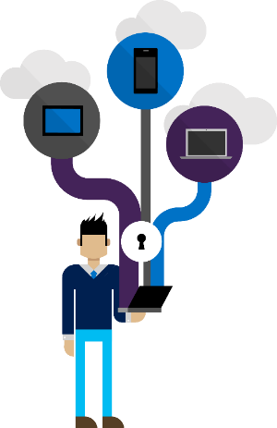
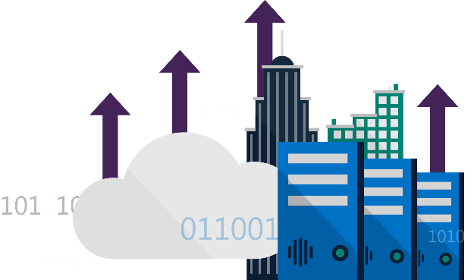
SharePoint Development Model
Evolution
50%
72%
“Nearly of large enterprises will likely have
hybrid cloud deployments
by the end of 2017”¹
of customers are leveraging cloud for their applications—from pilots to production apps²
Server Side Development
2001
ASP
Digital Dashboards,
File System Storage, etc.
2003
ASP.NET
ASP.NET Web Parts, Full Trust APIs, Server Side Event Receivers…
2007
ASP.NET
ASP.NET Web Parts, Full Trust APIs, Server Side Event Receivers…
2010
ASP.NET
ASP.NET Web Parts, Full Trust APIs, Server Side Event Receivers…
2013
ASP.NET
ASP.NET Web Parts, Full Trust APIs, Server Side Event Receivers…
Sources:
Gartner, Inc. 2013. Press Release: http://www.gartner.com/newsroom/id/2599315
451 Research, Hosting and Cloud Study, 2014

Slide 5


SharePoint
Portal Server 2001
SharePoint
Portal Server 2003
Office SharePoint
Server 2007
SharePoint
Server 2010
SharePoint
Server 2013
SharePoint
Server 2016
2001
2003
2006
2009
2012
2016
Microsoft
Managed Solutions
Microsoft
Online Services
Server Rendered Era
Client Rendered Era
Full Trust Code
Partial Trust Code
App Model
SharePoint Framework

Slide 6
Accelerating Web Development
2016
  Custom Presentation
UX Extensions
Data Access
Eventing
Solutions Host
Client Side and
Open Source
Client Side and Remotely Hosted
REST and Cleaner Contracts
Web Hooks and
Web Sockets
Cloud SaaS and
Client Side Logic
Customer
Consistent
Platform
Microsoft
Patterns
Enterprise-Grade
Modern Toolchain
User Focused

Slide 7

SharePoint Extensibility Principles
Build long-term, value-added services for all developers
Principles
To provide an Application Development Framework that aligns 1st and 3rd parties
To build industry leading client side solutions On-Premises and in the Cloud
Unlocking the potentials of SharePoint
and the Microsoft Graph on desktops
or any device

Slide 8
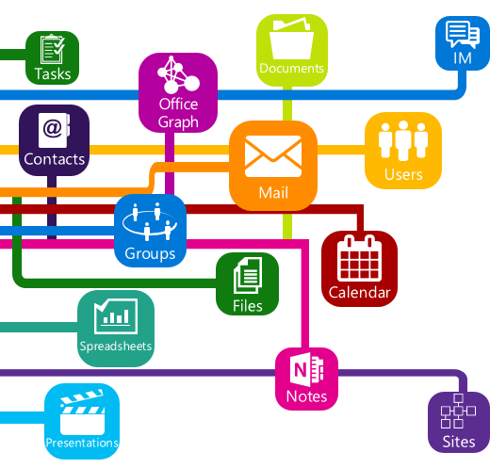
Graph Integration
Purpose-built APIs for SharePoint workloads
Includes lists, publishing, site management, and video
Web hooks for outbound notifications of changes in SharePoint lists, libraries, and sites

Slide 9

Open Source Tooling Support
Modern Tool Chain
Make all of the tools and technologies that internal engineers use to build available to third party developers
Office UI Fabric

Slide 10
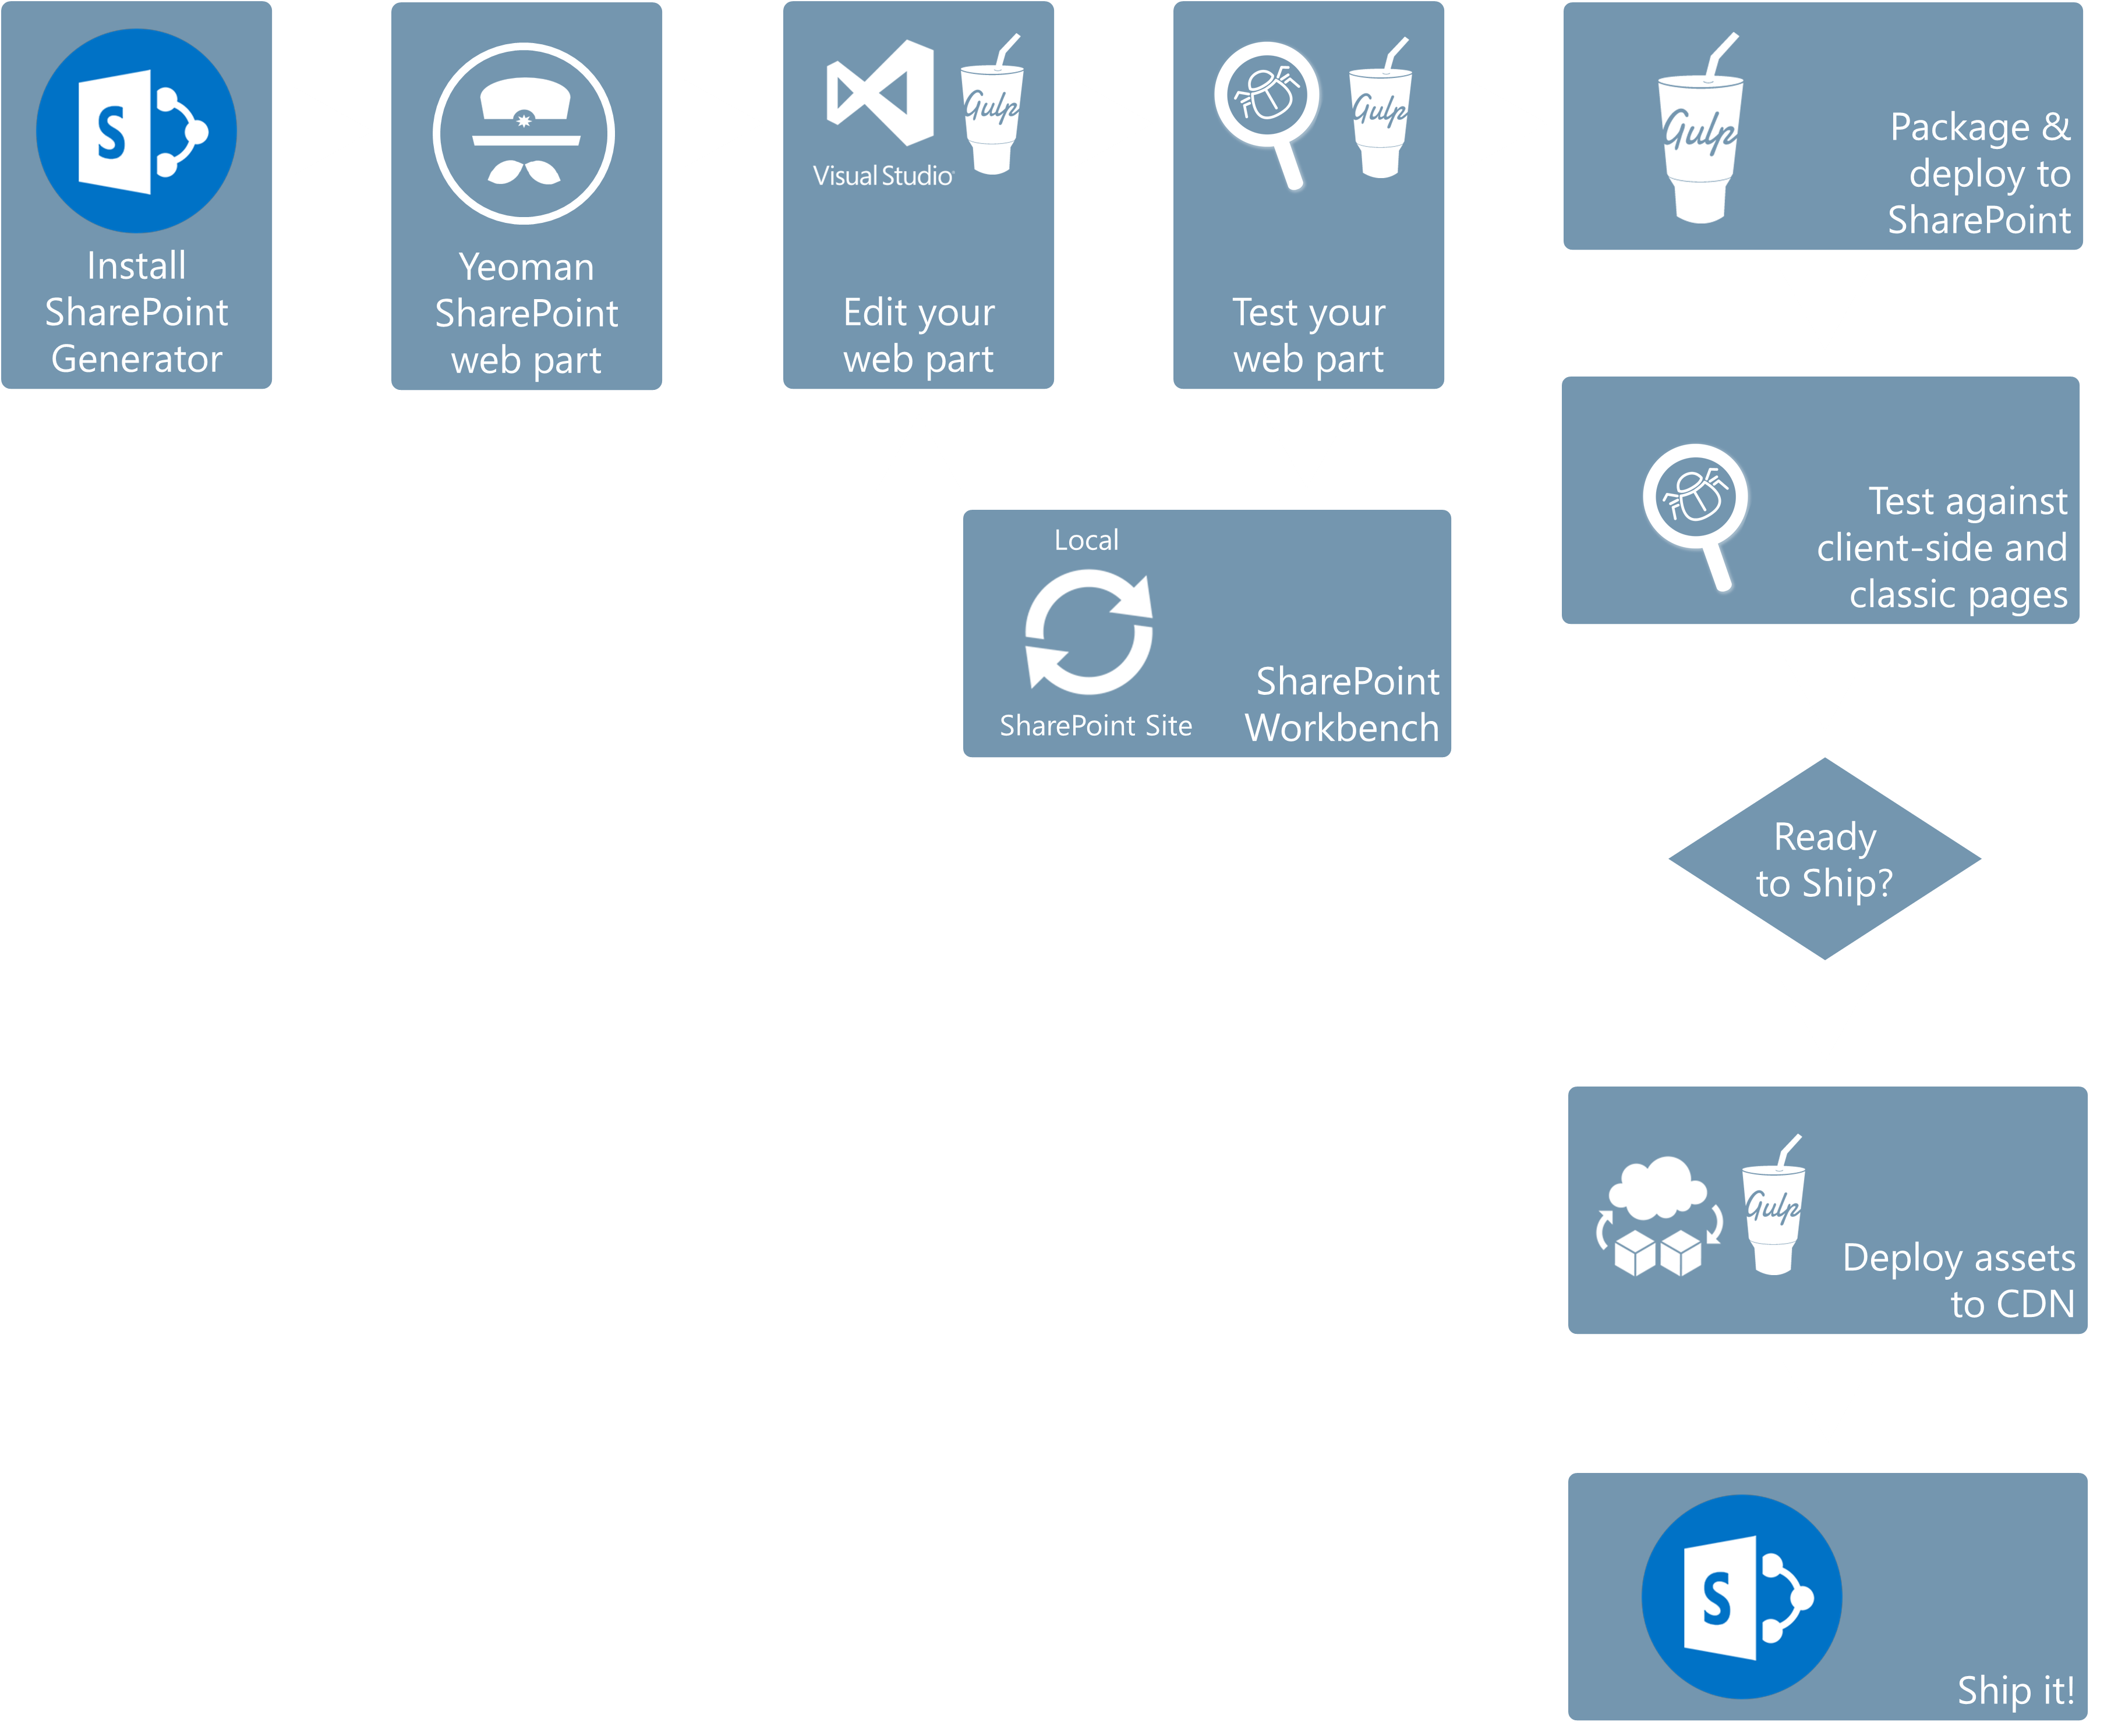
Modern Toolchain

Slide 12


Modern Toolchain

Slide 13
Modern Toolchain

Slide 14
Demo – Modern Toolchain

Slide 15
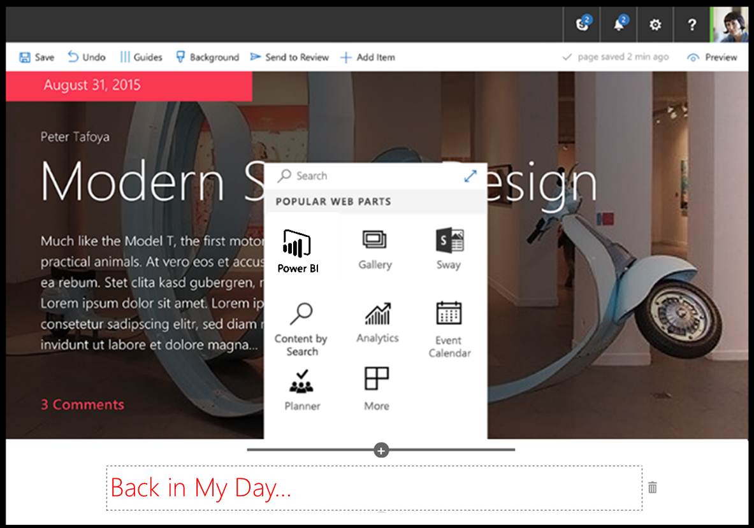
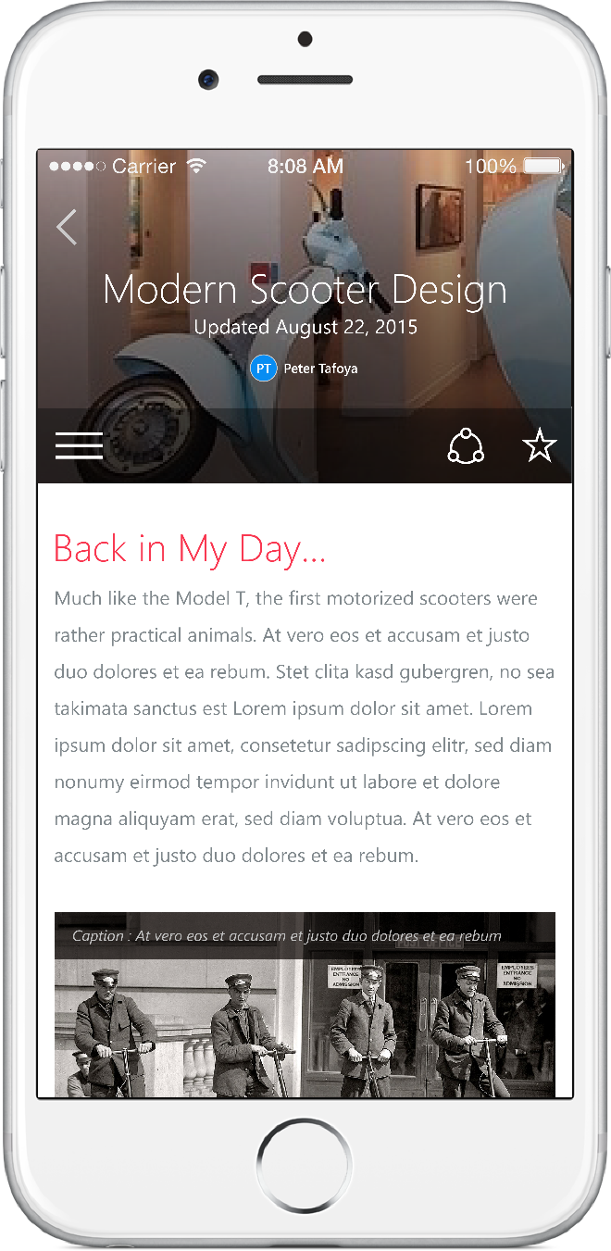
Scenarios
Enhancing the out of the box experience
Branding custom portals
Building custom Intranet Portals
Building custom Web Parts
Building vertical focused applications
Integrating with external systems

Slide 16
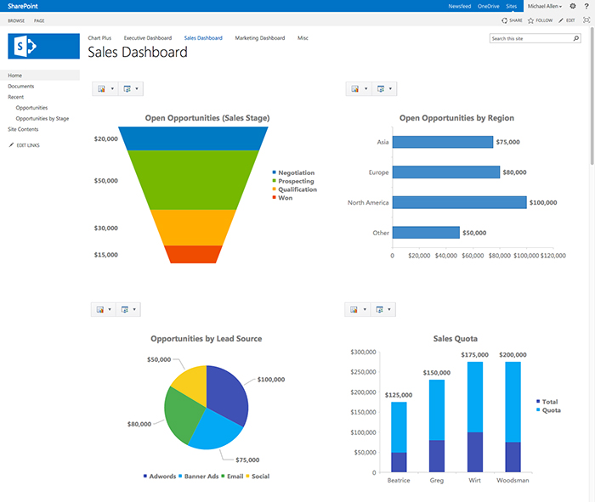
Client-side Web Parts
Web Part Value
End users add functionality to SharePoint Experiences
Configurable, reusable, purpose built components
built by developers
Framework for connecting related components
Context aware
Client-side Web Parts remain Web Parts
  Built for the modern, JavaScript-driven web
  Can run directly inside a SharePoint page,
  new and existing
  Web framework agnostic
  Support both on-premises and Office 365

Slide 17
Demo – Client Side Web Parts

Slide 18
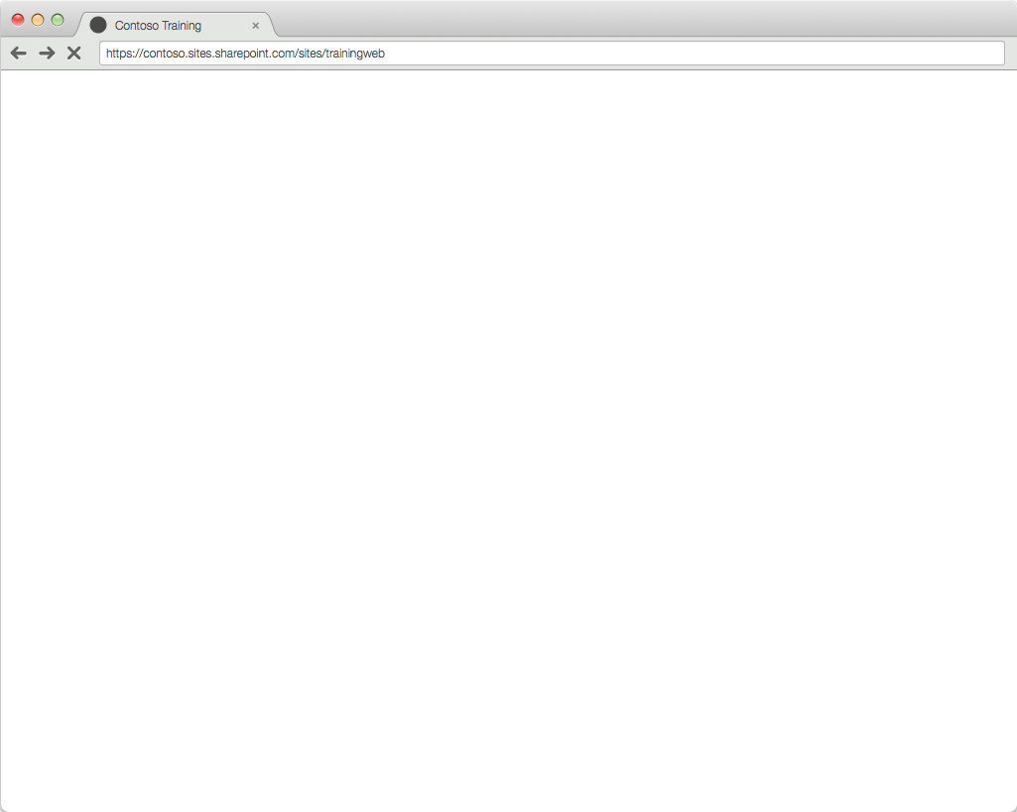


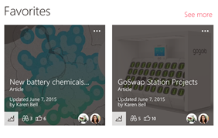
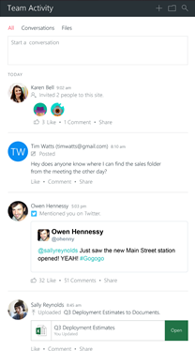
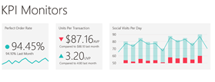
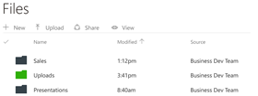
https://contoso.sharepoint.com/sites/learning/Default.aspx
Azure
…or 3rd Party Provider Hosted App
Office 365
SharePoint
Exchange
Delve
Web Parts & Canvas

Slide 19
Getting Started with the SharePoint Framework
Read the preview announcement at http://dev.office.com/blogs
Check out the documentation and samples at http://GitHub.com/SharePoint
Sign-up for the Office Developer Program at http://dev.office.com
Start developing

